Slide 1
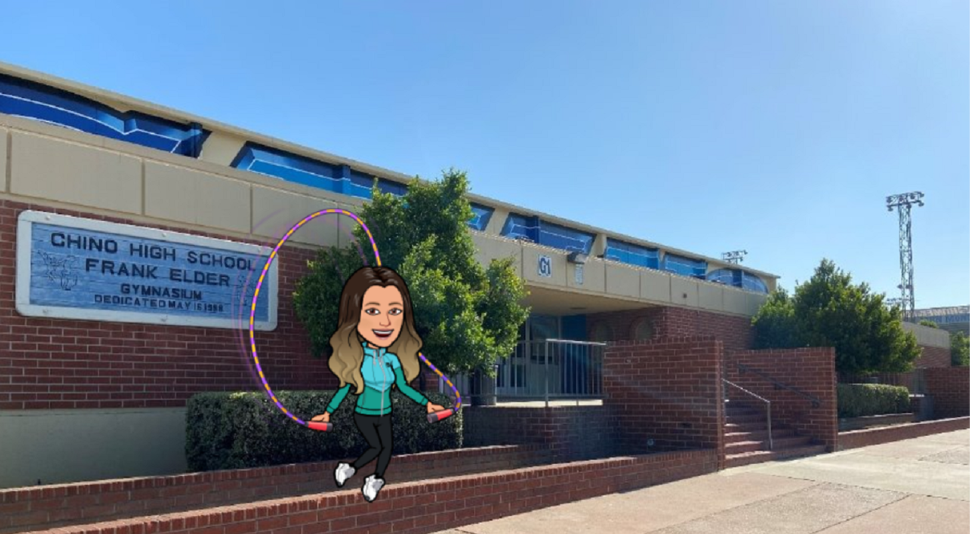
Welcome to Chino High School Physical Education
Thank you for coming… We will begin shortly

Slide 2
Contact Information
Jim Baty
Jim_Baty@chino.k12.ca.us
Heather Inglima
Heather_Inglima@chino.k12.ca.us
Tom Inglima
Tom_Inglima@chino.k12.ca.us
Joseph LaRosa
Joseph_LaRosa@chino.k12.ca.us

Slide 3
PARENT SQUARE APP
@chinohigh_pe

Slide 4
Classroom Expectations
Safe
Follow directions and be aware of surroundings
Responsible
Secure items and use lockers rooms as they are intended for
Respectful
Respect ourselves, classmates, classwork, teachers and our community
Resilient
Actively participate and engage in all we do

Slide 5
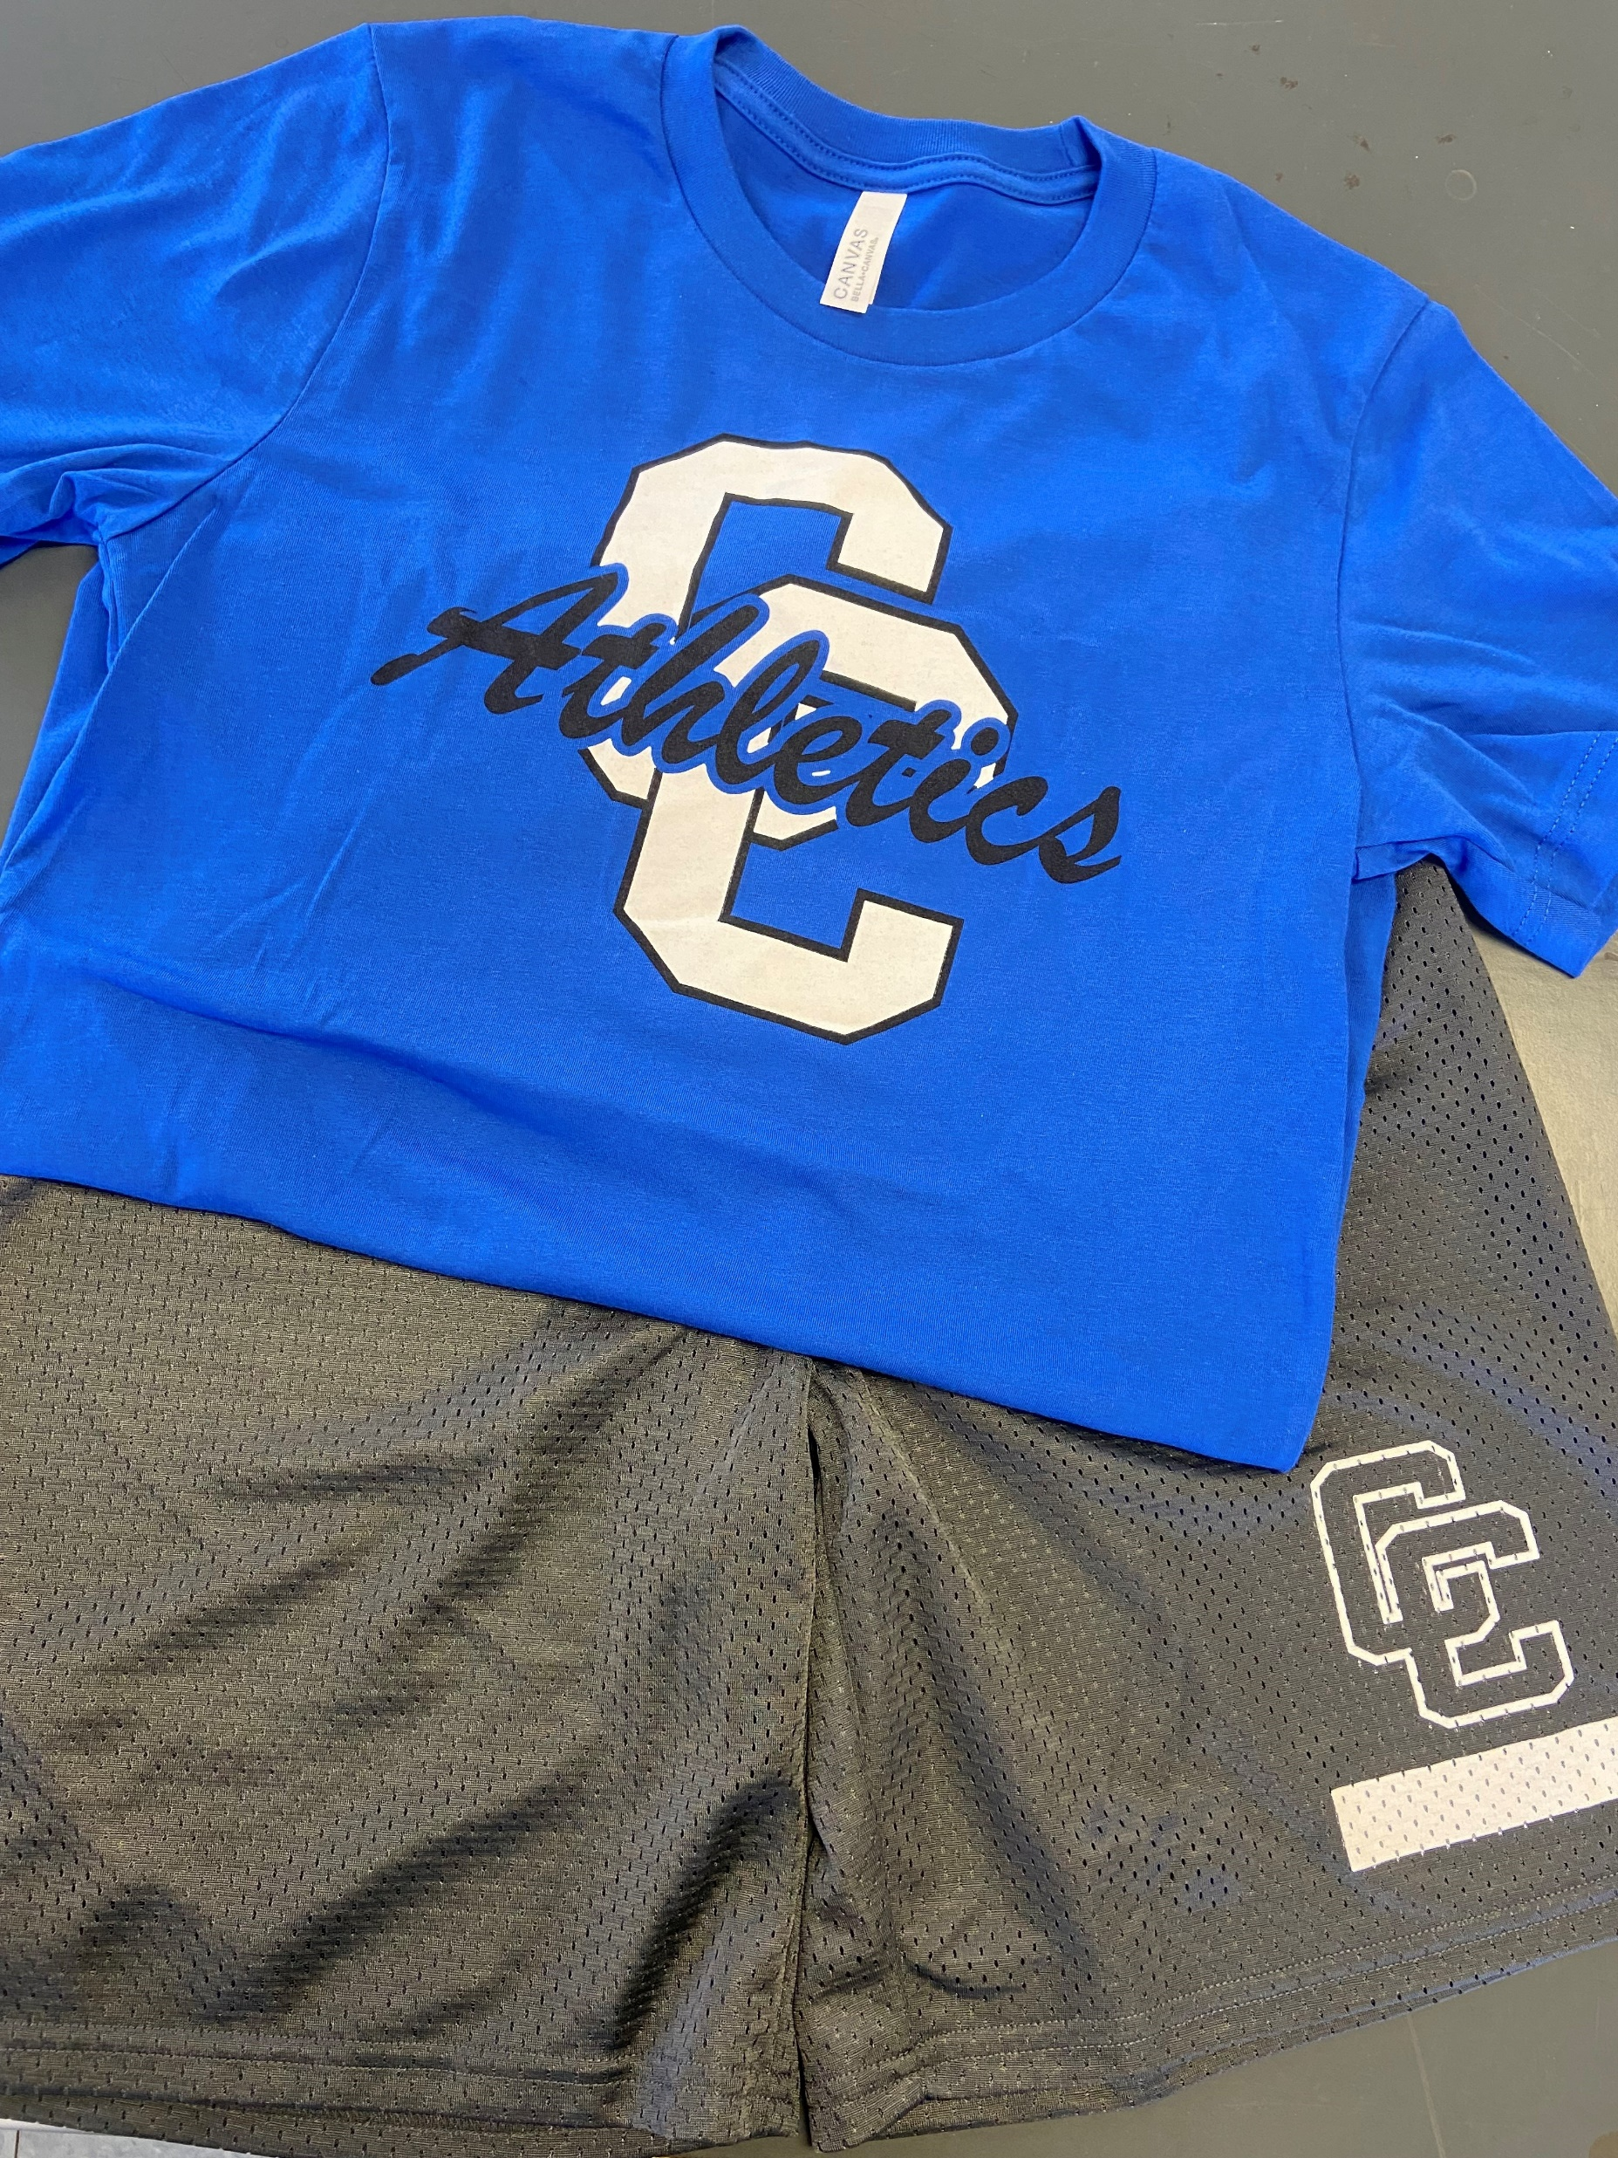
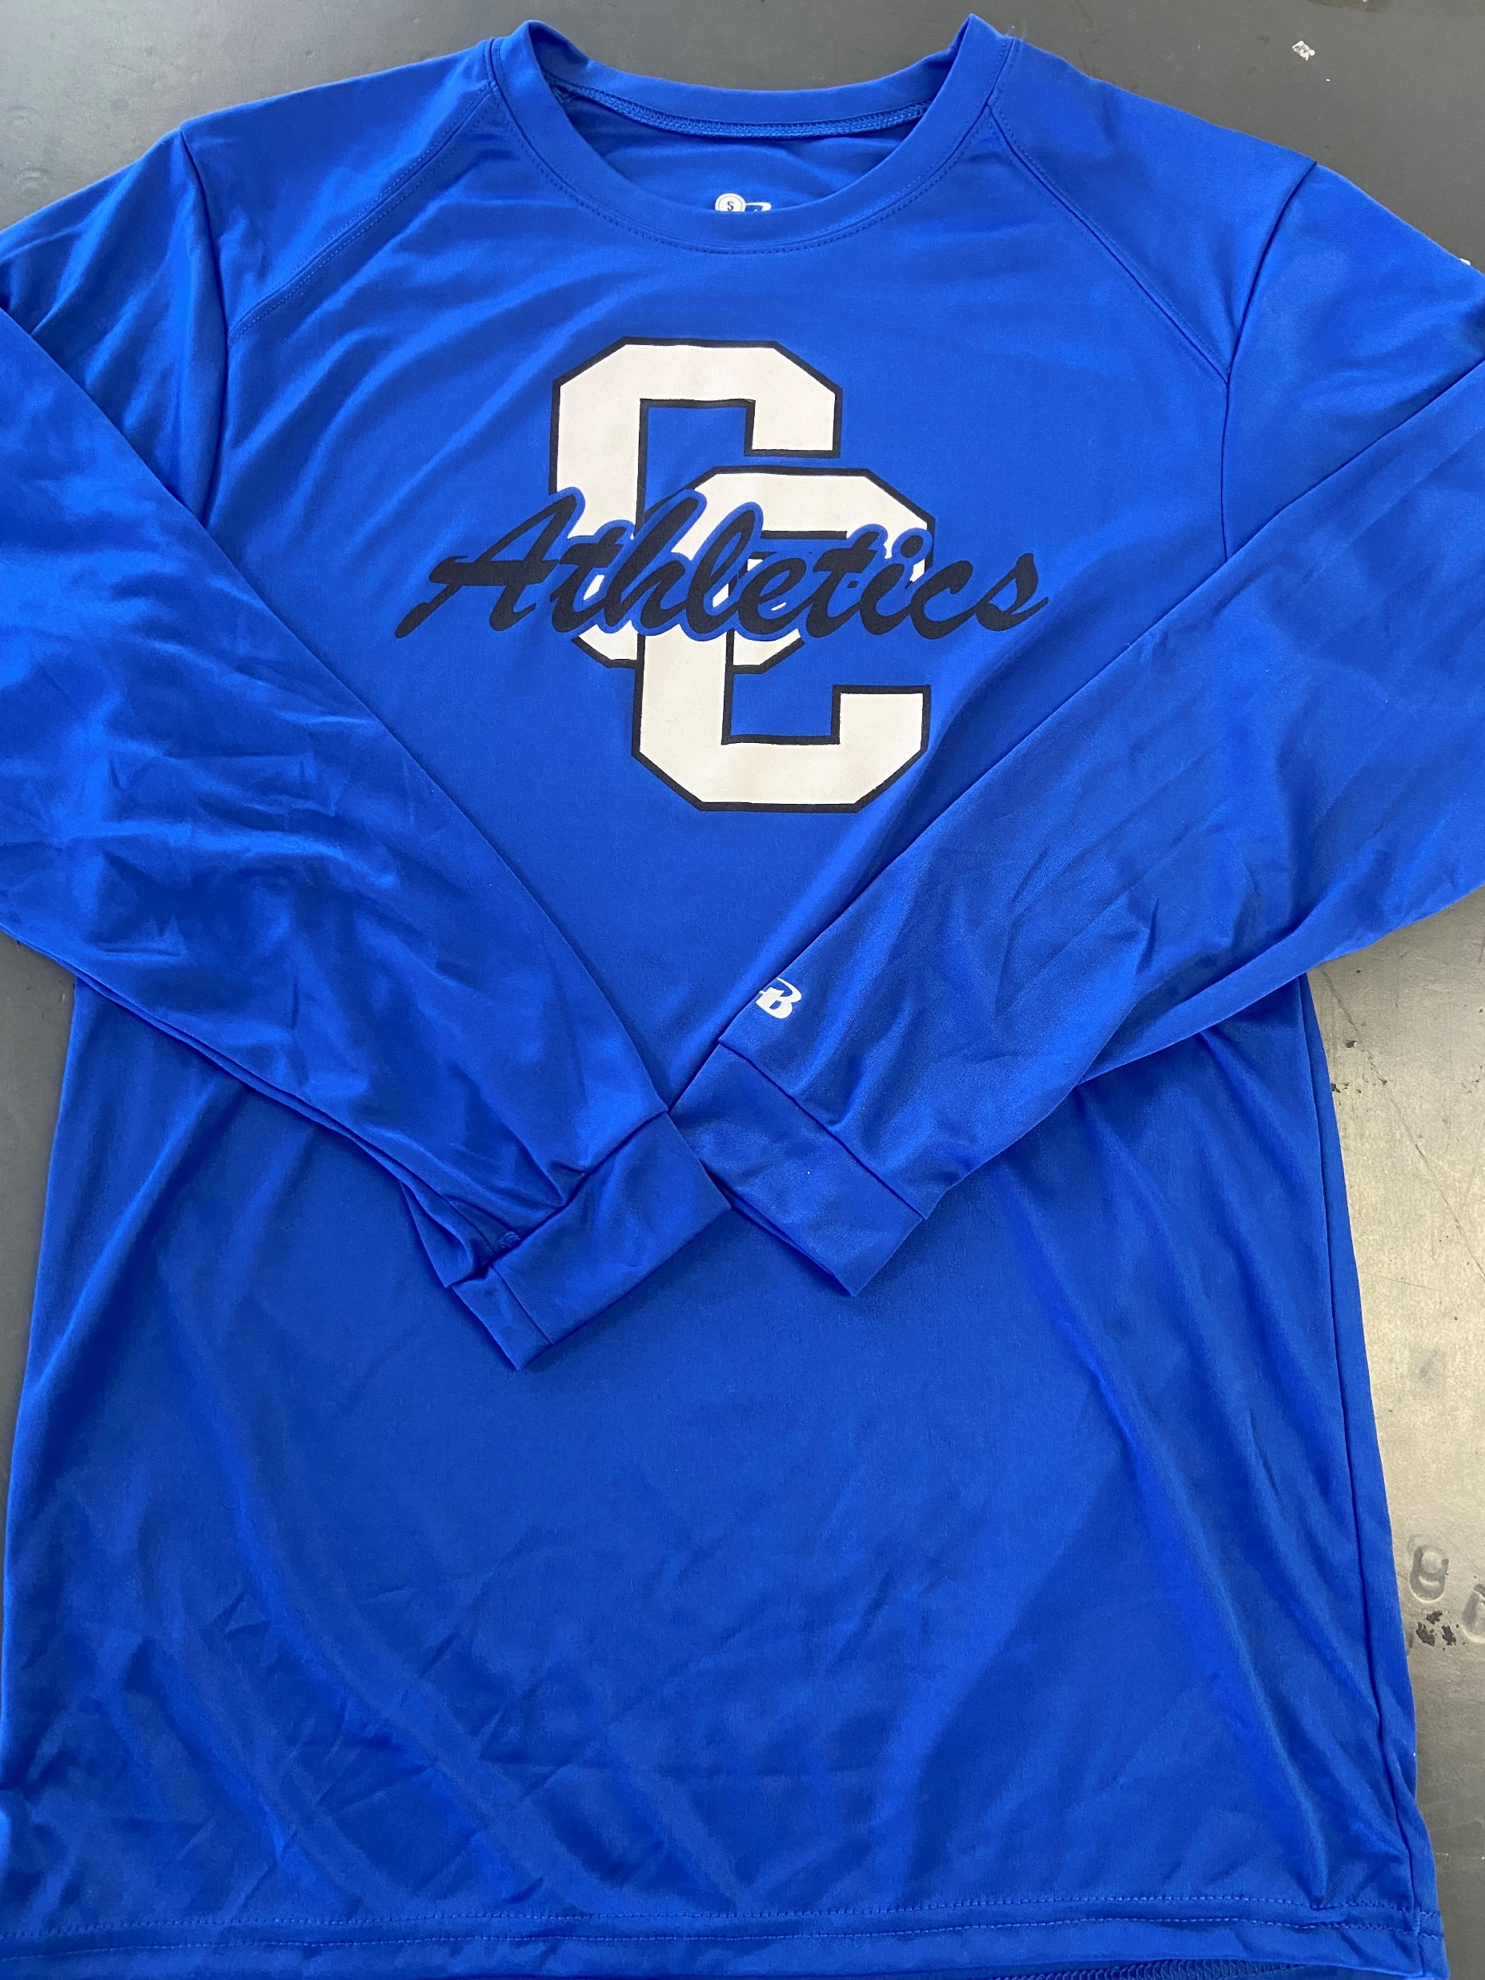
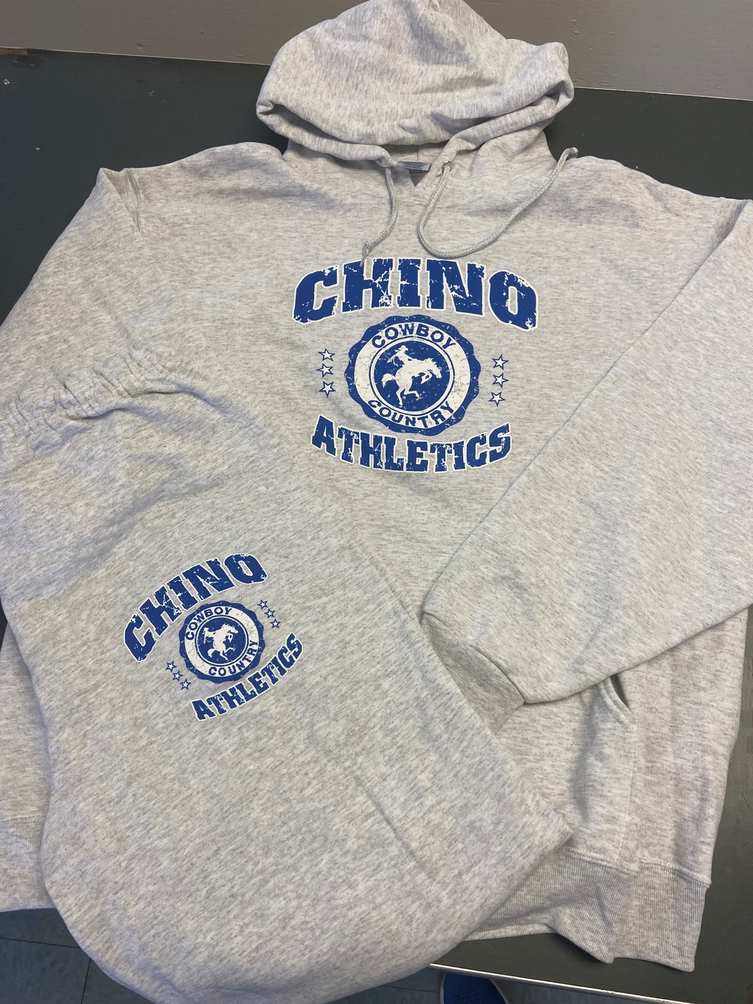
Chino High PE Clothes
Shirts- $10
Shorts- $10
Sweatshirts-$25
Sweats-$20

Slide 6
Daily Participation Credit
Come to class on time
Dressed out properly, head to toe
Actively participates
Positive Attitude
Great Effort

Slide 7
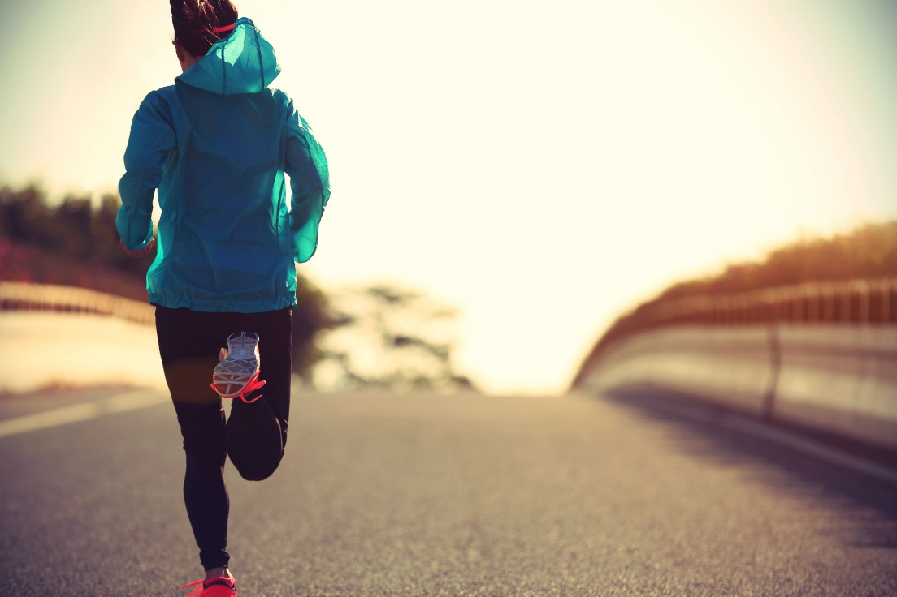
Typical Week in PE:
1/2 Mile Times | Points
0:00-7:30 | 10
7:31-20:00 | 0
20:01 < | -5
Laps 3 and 4 must complete within 20:00
Mondays- Bootcamp
Tuesday- Activity
Wednesday-Cardio Day
Thursday- Activity
Friday- Activity
10 pts Mile Scale

Slide 8
Yes, we do a swim unit!
It is part of the California State PE Standards
BUT.. It is more fun than work and they may possibly learn a useful skill.

Slide 9
EXCEPT on Cardio Days

Slide 10
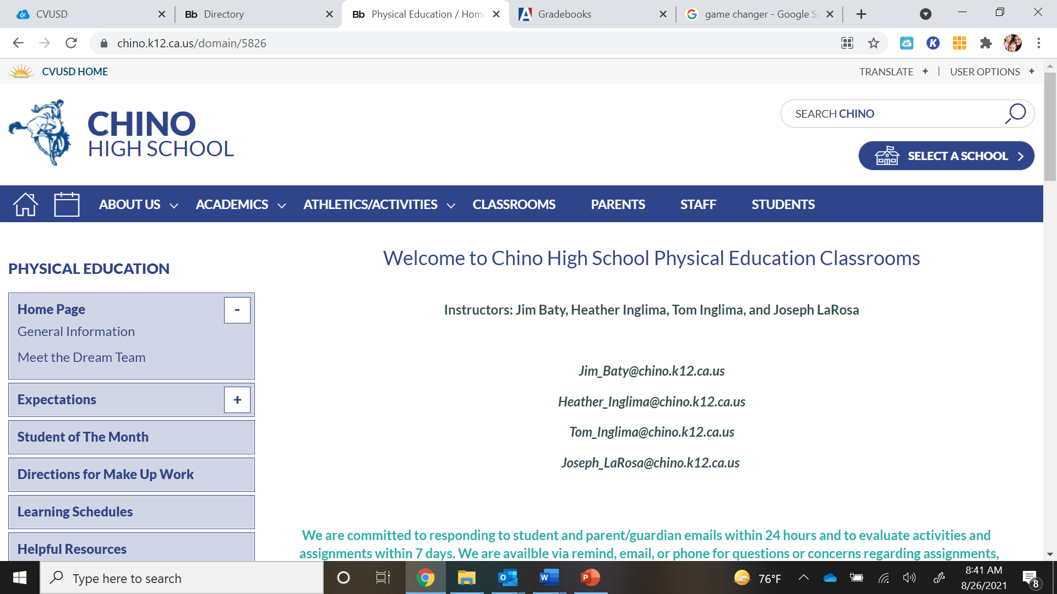
https://www.chino.k12.ca.us/domain/5826
We are committed to your student’s success

